Slide 1









GAMIFIED LEARNING
Progress TRACKER
TURNING LEARNING INTO AN EXCITING ADVENTURE
1

Slide 2


OUR TEAM
BIBEK KAPALI
BIJAY KOIRALA
26602076
26602078
2

Slide 3





INTRODUCTION
PROBLEM OF STATEMENT
OBJECTIVES
REQUIREMENT ANALYSIS (F, NF)
DATA MODELING: ER
PROCESS MODELING: DFD
SUMMARY
OVERVIEW
3

Slide 4




INTRODUCTION
Combination of
Edu. and game system
Discord badges style
4

Slide 5




PROBLEM STATEMENT
Problems seen in old systems :
The boring ui/ux design of the existing system and the rewards are main problems.
TEACHERS OFTEN LACK INSIGHTS INTO EACH STUDENT'S LEARNING CAPACITY.
STUDENTS FREQUENTLY STRUGGLE TO ACCESS ASSIGNMENTS AND NOTES, ESPECIALLY THOSE OUTSIDE THEIR CURRENT COURSEWORK.
5

Slide 6
OBJECTIVE OF THIS SYSTEM
To show learning progress in a line chart.
To help teachers understand each student's struggle.
To keep parents informed about their child’s learning journey.
To make learning fun with badges.
6

Slide 7

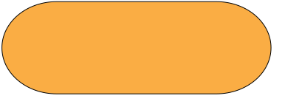
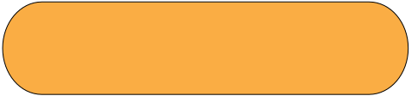
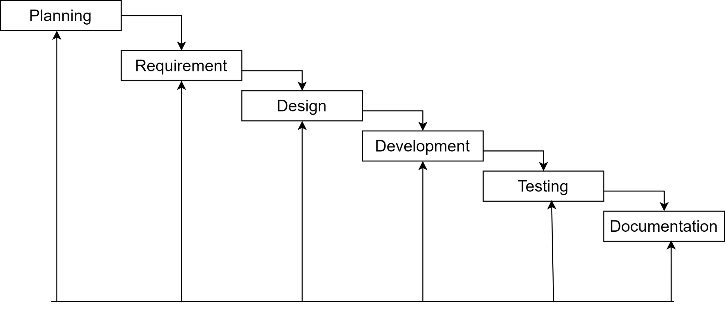
Methodology
Iterative Waterfall model
7
Notes:
1.7.2013
• Admin can perform all functional tasks.
• Teacher can perform tasks related to viewing user personal info including overall and posting works but not modifying registration of any user which changes personal data.
• Student can register once and access tasks, assignments, notes, and their own profile & dashboard.
‹#›

Slide 8
REQUIREMENT ANALYSIS
1. Functional req
Functional requirements specify what the system should do.
They define the functions, features, and behavior of the system.
2. Non Functional
Non-functional requirements define the quality attributes, performance, and constraints of the system.
They specify how the system should perform.
8

Slide 9

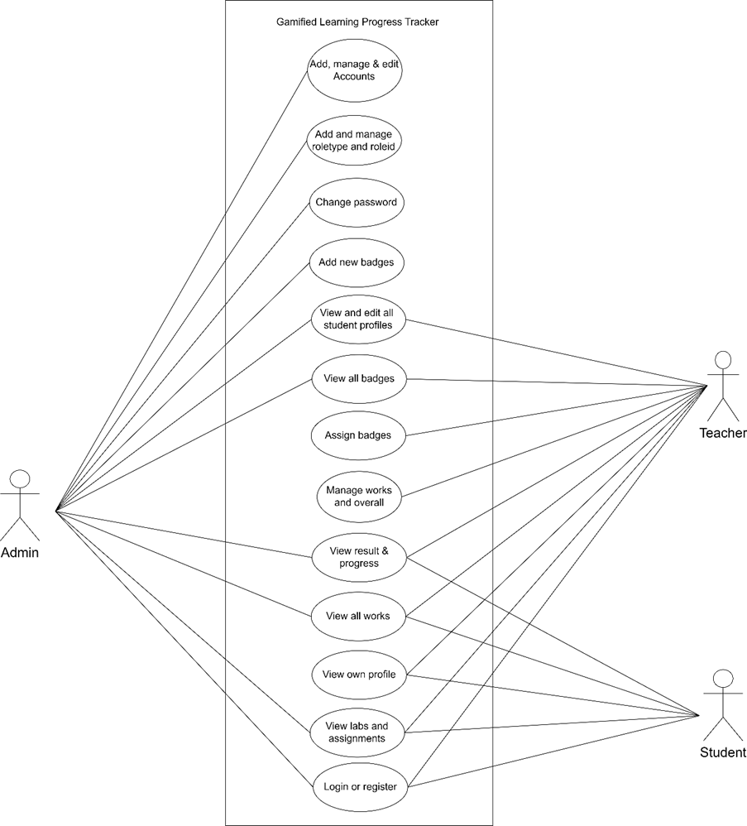
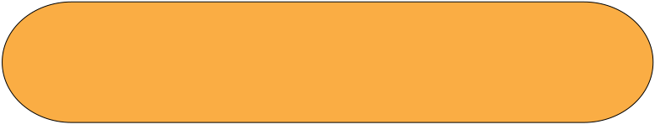
USE CASE DIAGRAM
Helps in understandind requirements.
9
Notes:
1.7.2013
• Admin can perform all functional tasks.
• Teacher can perform tasks related to viewing user personal info including overall and posting works but not modifying registration of any user which changes personal data.
• Student can register once and access tasks, assignments, notes, and their own profile & dashboard.
‹#›

Slide 10




DATA MODELING
Data modeling is the process of diagramming data flows.
The goal of data modeling to illustrate the types of data used and stored within the system, the relationships among these data types, the ways the data can be grouped and organized and its formats and attributes.
Entity-Relationship (ER) modeling is a technique used to visually represent the structure of a database.
10

Slide 11
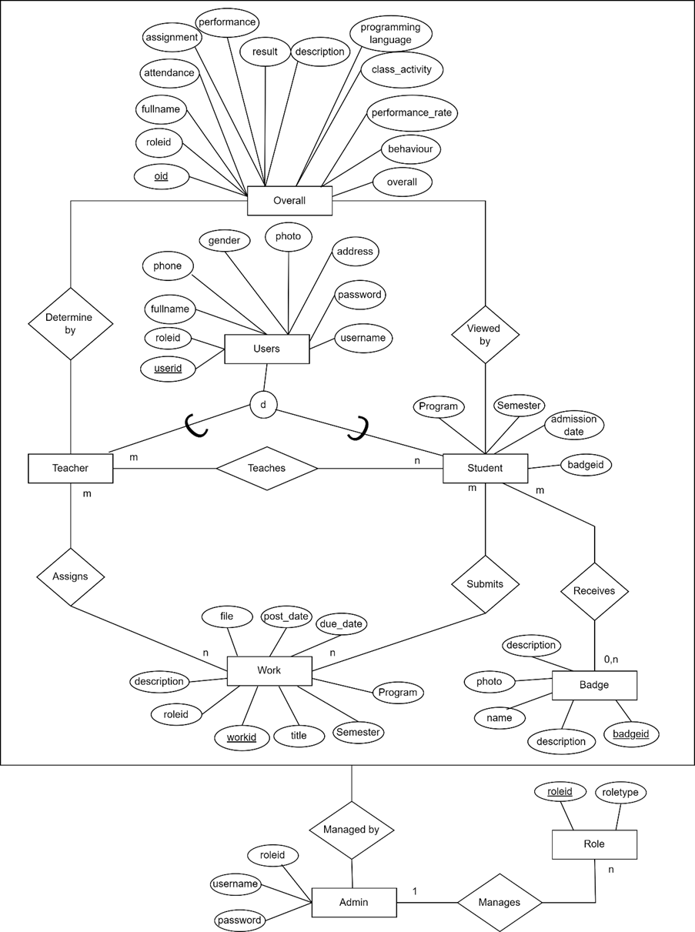
ER
11
Notes:
1.7.2013
‹#›

Slide 12




PROCESS MODELING
Process modeling is the graphical representation of business processes or workflows.
By creating a graphical model of how work needs to be done, it allows organizations to easily see where resources are being wasted, or where user productivity can be improved.
12

Slide 13
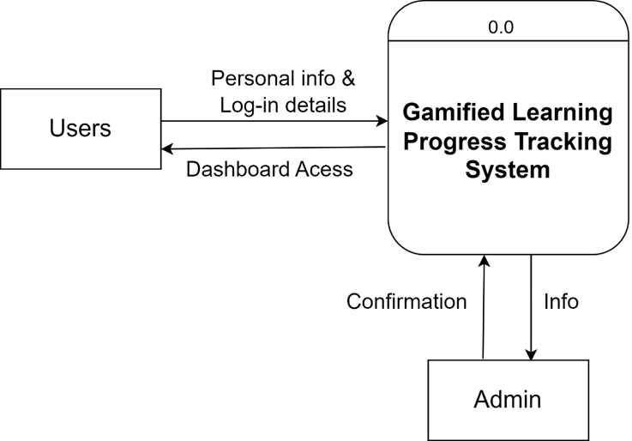
DFD LEVEL 0
(LOGICAL)
13
Notes:
1.7.2013
In this context, the DFD illustrates that users (teachers and students) need to register their personal information, such as username, photo, password, full name, phone number, and address, into the system.
‹#›

Slide 14
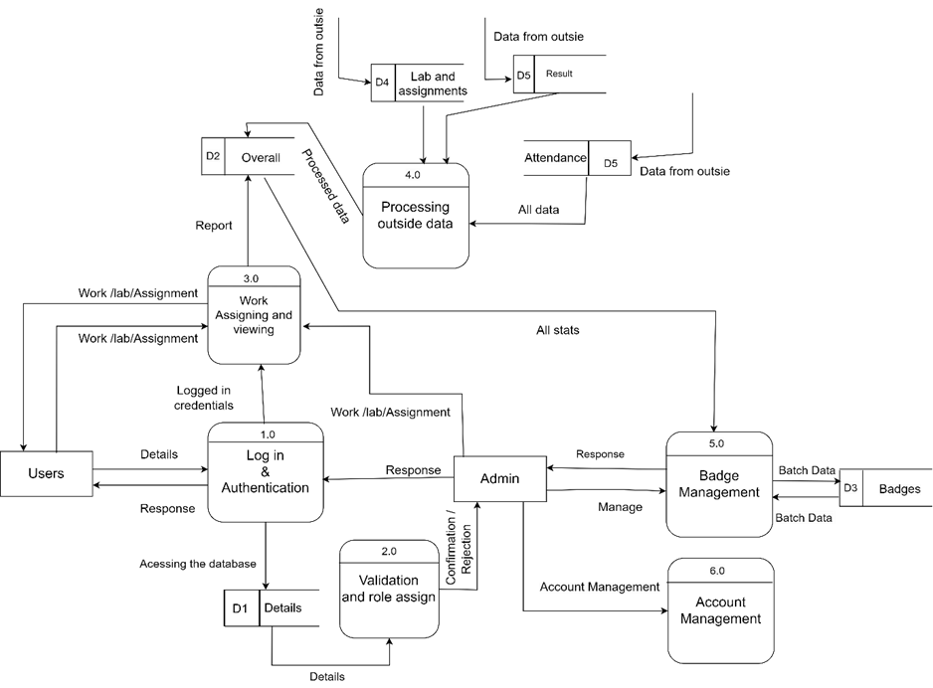
DFD LEVEL 1
14
Notes:
1.7.2013
In a Level 1 DFD, processes are labeled as 1.0, 2.0, 3.0, etc., showing the main functions and their interactions. It is broken down in more detailed processes like user registration, data verification, and access control by showing how data is flowing to which part.
‹#›

Slide 15

IMPLEMENTING TOOLS
• | Case Tool: Draw.io was used for diagramming and visualizing the system architecture.
• | Programming Languages: HTML, CSS, JavaScript (for frontend interactions), PHP (for backend logic), and MySQL (for database management) formed the core of the system's development.
• | Development Environment: Tools such as VS Code for coding, XAMPP for local server hosting, Chrome for testing, and GitHub for version control were utilized to streamline the development process.
15

Slide 16
FINAL OUTCOMES
·Admin Role: Users with admin privileges have full access to the system, including adding new roles, deleting users, managing badges, modifying account information, and creating/editing assignments.
·Teacher Role: Teachers can view student profiles, manage overall progress, and post assignments.
·Student Role: Students can view their profiles, assignments, and laboratory information.
16

Slide 17
SUMMARY
The "Gamified Progress Tracker" monitors student progress and rewards them with badges, using a line graph to visualize performance. It enables teachers to understand student capabilities and provides universal access to assignments, notes, and questions, fostering inclusive learning. This system enhances engagement and streamlines resource accessibility, creating an effective and motivating educational environment.
17

Slide 18





DO YOU HAVE ANY QUESTION?
18

Slide 19



THANK
YOU
FOR YOUR ATTENTION
19

